Slide 1
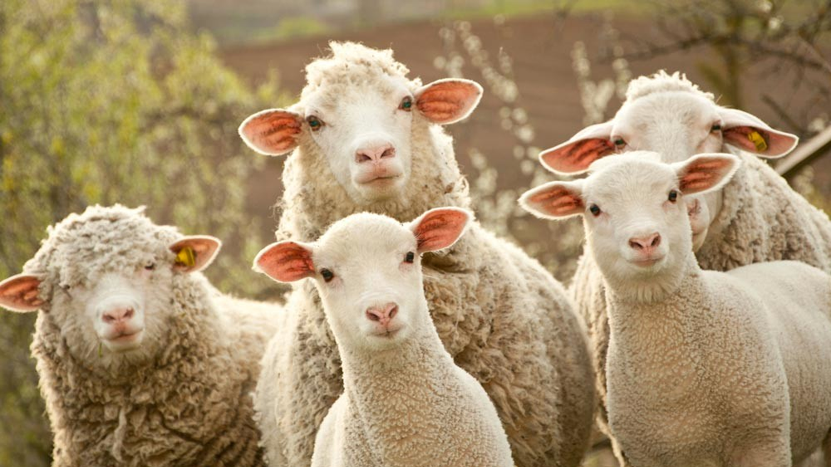
Saul’s Rebellion Against God’s Word 3
1 Samuel 15:23-35

Slide 2
No one can make you sin.
Saul’s sin was always someone else’s fault.
The LORD wasn’t Saul’s God;
He was Samuel’s.
Saul was Saul’s god.
God doesn’t need our “donations.”

Slide 3
Sacrifice is worthless when the heart is in rebellion!
Rejecting God’s Word result’s
in God’s rejection in return.
Our problem is when we will not submit to the authority of the Word of God.

Slide 4
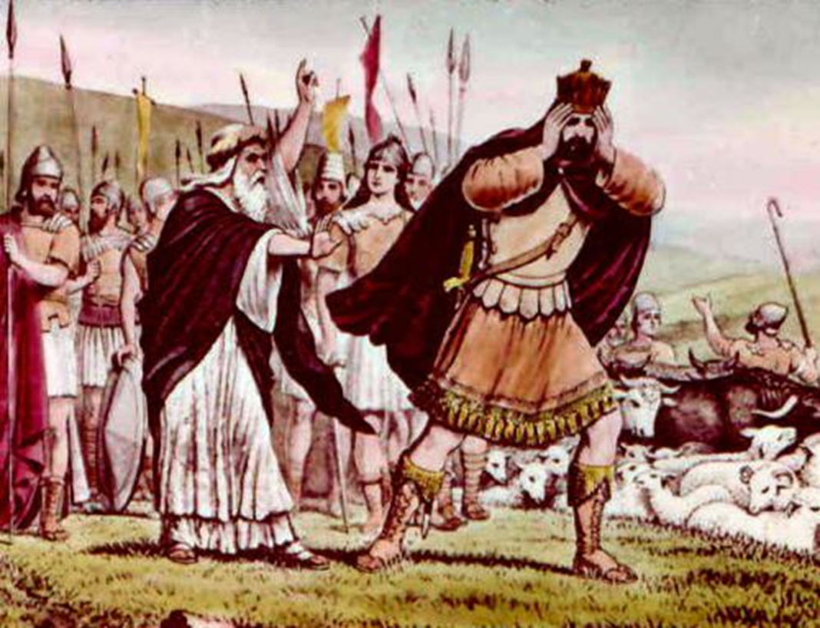
Saul’s dissimulation.
Correct analysis?
Problem: when leaders compromise God’s Word in order to please people!
Saul does not change. Repentance is required.

Slide 5
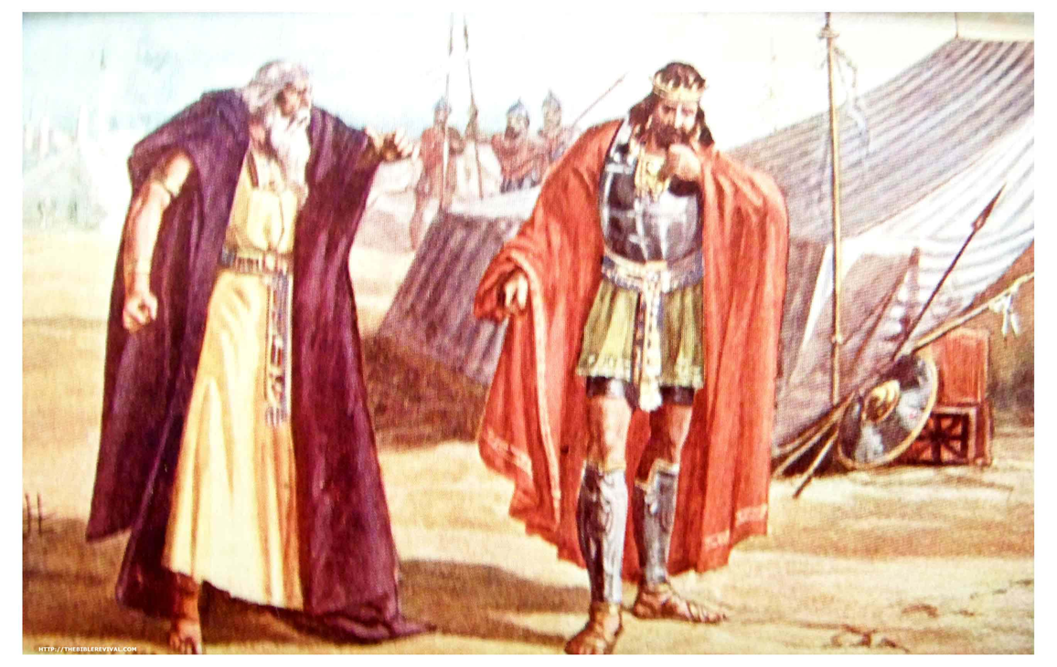
Saul’s show of godliness.
Saul is like wicked Pharaoh!

Slide 6
Exodus 10:16-20 Then Pharaoh called for Moses and Aaron in haste; and he said, I have sinned against the LORD your God, and against you. 17 Now therefore forgive, I pray thee, my sin only this once, and intreat the LORD your God, that he may take away from me this death only. 18 And he went out from Pharaoh, and intreated the LORD. 19 And the LORD turned a mighty strong west wind, which took away the locusts, and cast them into the Red sea; there remained not one locust in all the coasts of Egypt. 20 But the LORD hardened Pharaoh's heart, so that he would not let the children of Israel go.

Slide 7
Luke 18:10-14 Two men went up into the temple to pray; the one a Pharisee, and the other a publican. 11 The Pharisee stood and prayed thus with himself, God, I thank thee, that I am not as other men are, extortioners, unjust, adulterers, or even as this publican. 12 I fast twice in the week, I give tithes of all that I possess. 13 And the publican, standing afar off, would not lift up so much as his eyes unto heaven, but smote upon his breast, saying, God be merciful to me a sinner. 14 I tell you, this man went down to his house justified rather than the other: for every one that exalteth himself shall be abased; and he that humbleth himself shall be exalted.

Slide 8
Saul’s loss of the kingdom.
Loss at the Judgment Seat of Christ.

Slide 9
Romans 8:15-17 For ye have not received the spirit of bondage again to fear; but ye have received the Spirit of adoption, whereby we cry, Abba, Father. 16 The Spirit itself beareth witness with our spirit, that we are the children of God: 17 And if children, then heirs; heirs of God, and joint-heirs with Christ; if so be that we suffer with him, that we may be also glorified together.

Slide 10
2 Timothy 2:11-13 It is a faithful saying: For if we be dead with him, we shall also live with him: 12 If we suffer, we shall also reign with him: if we deny him, he also will deny us: 13 If we believe not, yet he abideth faithful: he cannot deny himself.

Slide 11
God’s repentance over Saul.
Notice that God regretted making Saul king not because God messed up, but because Saul did!
God didn’t change – Saul did! So now God has to remove Saul.

Slide 12

Saul is a fool.
Who did Saul blame for his sin?
Now who is Saul trying to impress?
Saul doesn’t care about God’s Word, only his reputation. He doesn’t care about getting right with God.

Slide 13
No one gets away with sin.

Slide 14
Numbers 32:23 But if ye will not do so, behold, ye have sinned against the LORD: and be sure your sin will find you out.
1 Corinthians 4:5 Therefore judge nothing before the time, until the Lord come, who both will bring to light the hidden things of darkness, and will make manifest the counsels of the hearts: and then shall every man have praise of God.

Slide 15
Isaiah 59:2 But your iniquities have separated between you and your God, and your sins have hid his face from you, that he will not hear.

Slide 16
Is the Word of God authoritative over your life?

Slide 17
Saul’s Rebellion Against God’s Word 3
1 Samuel 15:23-35

